Slide 1
TATA iQ
Python Training

Slide 2
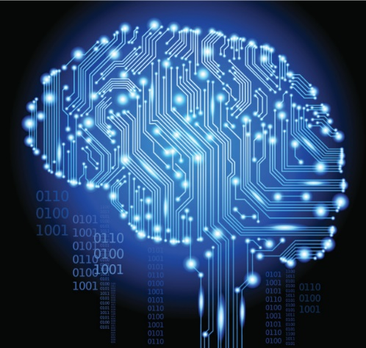
What is Programming Language

Slide 3
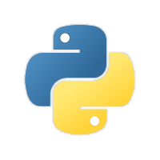

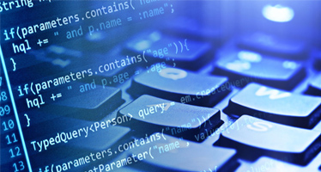
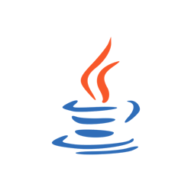
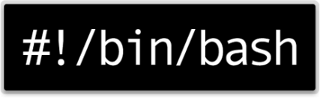
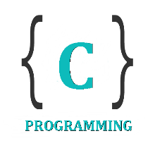

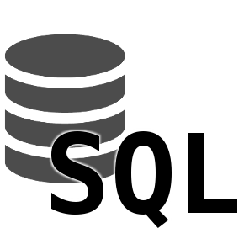
What is Programming Language
A programming language is a formal computer language or constructed language designed to communicate instructions to a machine, particularly a computer.
Programming languages can be used to create programs to control the behaviour of a machine or to express algorithms.

Slide 4
Python Introduction

Slide 5

What is Python
Python is an interpreted, object-oriented, high-level programming language with dynamic semantics.
Its high-level built in data structures, combined with dynamic typing and dynamic binding, make it very attractive for Rapid Application Development, as well as for use as a scripting or glue language to connect existing components together.
Guido van Rossum

Slide 6
Why Python?

Slide 7






Why Python ?
Easy-to-learn and easy-to-maintain
Huge collection of library
Data management(upload, extract)
Versatile Application ( GUI, Web, OS, Data Science, Apps, Mobile)
Faster Development/productivity
Interpreted and scripting language

Slide 8
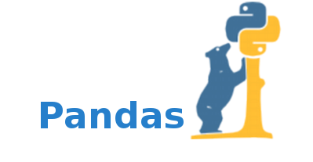
Why do we use Python?
Mine/Extract data from various different formats(web, excel, text, logs, xml, csv, html etc..)
Data munging/cleaning/preparation
Data management(upload, extract)
Automation
Scripting
Data Analysis
pandas is a Python package providing fast, flexible, and expressive data structures designed to make working with “relational” or “labeled” data both easy and intuitive.

Slide 9
Python History

